Slide 1
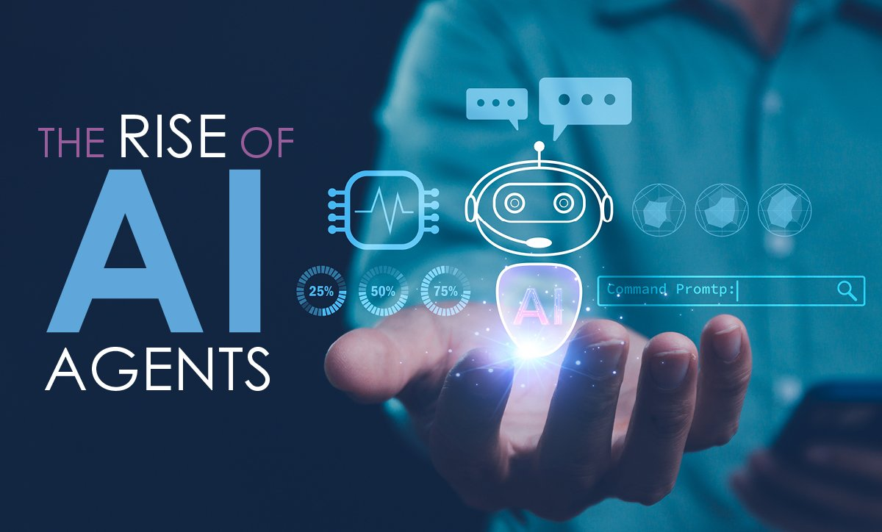
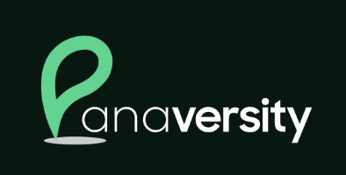

Zia Khan
MBA, MSE, MAC, MA, CPA, CMA
https://www.linkedin.com/in/ziaukhan/
https://www.facebook.com/ziakhan/
Notes:
"The Rise of Agentic AI," explores the rapid evolution of artificial intelligence, particularly Agentic AI. Also covers our vision and implementation.

Slide 2
Presentation Outline: Building the Future
The Rise of Agentic AI
Agentia World Vision
AI-First and Cloud-First Development
DACA Design Pattern
Road to AGI
The Journey of Agentic AI
Focus on Vertical Agentic Solutions
One Person Unicorn Possible Now
Call to Action

Slide 3
The Three Waves of AI
Predictive AI
Generative AI
Agentic AI
Focus on analyzing data to predict outcomes.
Analyze past data to predict future outcomes.
Why It Mattered: Enabled data-driven decision-making.
Focus on creating content from data.
Creating content (text, images, code, videos).
Why It Mattered: Empowered creativity and productivity.
Focus on autonomous actions and learning iteratively.
Autonomous actions, environment interaction, iterative learning.
Why It Matters: AI becomes proactive, managing complex tasks.

Slide 4
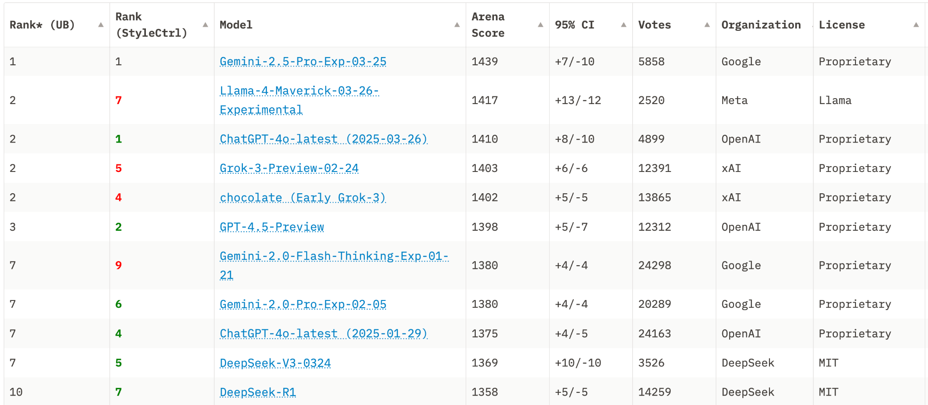
Chatbot Arena LLM Leaderboard
Community-driven Evaluation for Best LLMs
Notes:
https://huggingface.co/spaces/lmarena-ai/chatbot-arena-leaderboard

Slide 5
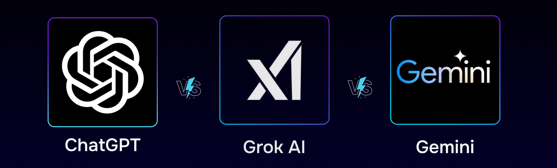
Generative AI: A Three-Year Revolution
Transformed content creation (text, images, code).
Paved the way for agentic AI’s autonomous capabilities.
From creativity to action, AI redefines possibilities.
Notes:
https://www.peppercontent.io/blog/chatgpt-vs-grok-ai-vs-gemini-ai-everything-you-need-to-know-about-these-powerful-ai-assistants/

Slide 6
What is an AI Agent?
Definition: An autonomous entity that perceives, decides, and acts in digital or physical environments.
Types:
Software Agents: Operate in digital systems (e.g., chatbots, workflows).
Physical Agents: Interact with the physical world (e.g., robots, vehicles).
Role in DACA:
Core components driving intelligent automation.
Agents are the building blocks of Agentia World.

Slide 7
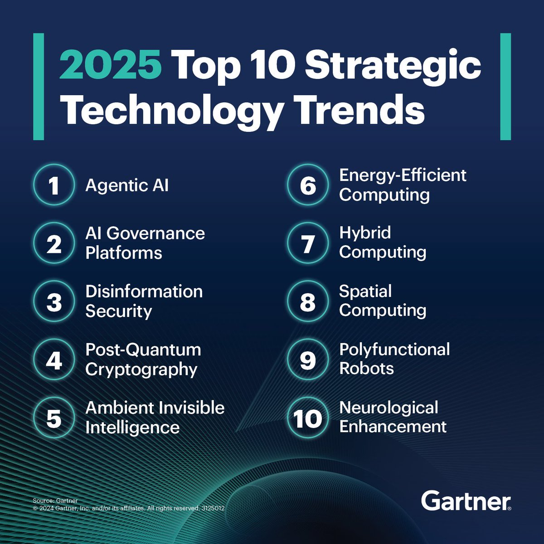
Notes:
https://www.gartner.com/en/articles/top-technology-trends-2025

Slide 8
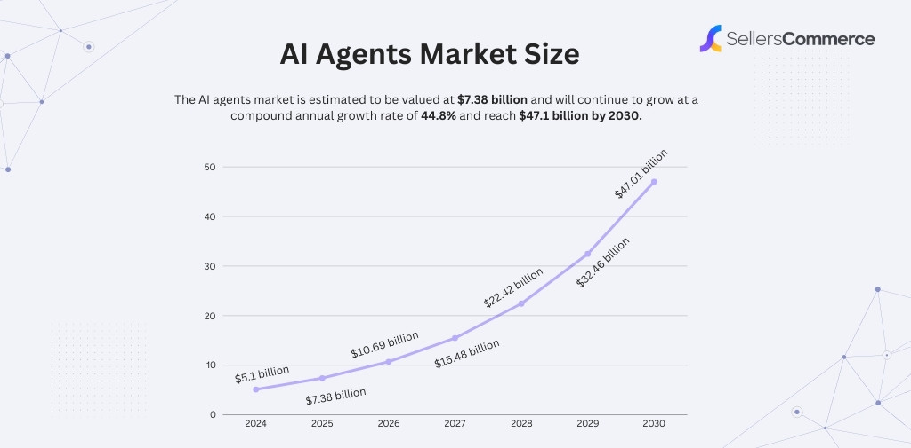
Notes:
https://www.sellerscommerce.com/blog/ai-agents-statistics/

Slide 9
Our Vision: Agentia World
Picture a world where everything is an AI agent – from your coffee machine to entire cities.
A dynamic, living network seamlessly integrated into daily life.
Systems communicating through sophisticated, intelligent dialogues, not outdated APIs.
A vision that's both digital and physical.

Slide 10
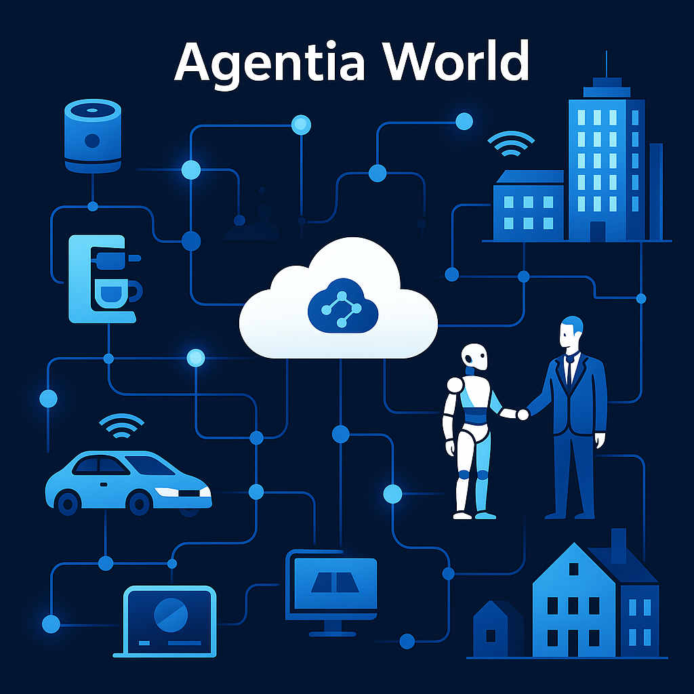
Our Vision: A World Transformed

Slide 11
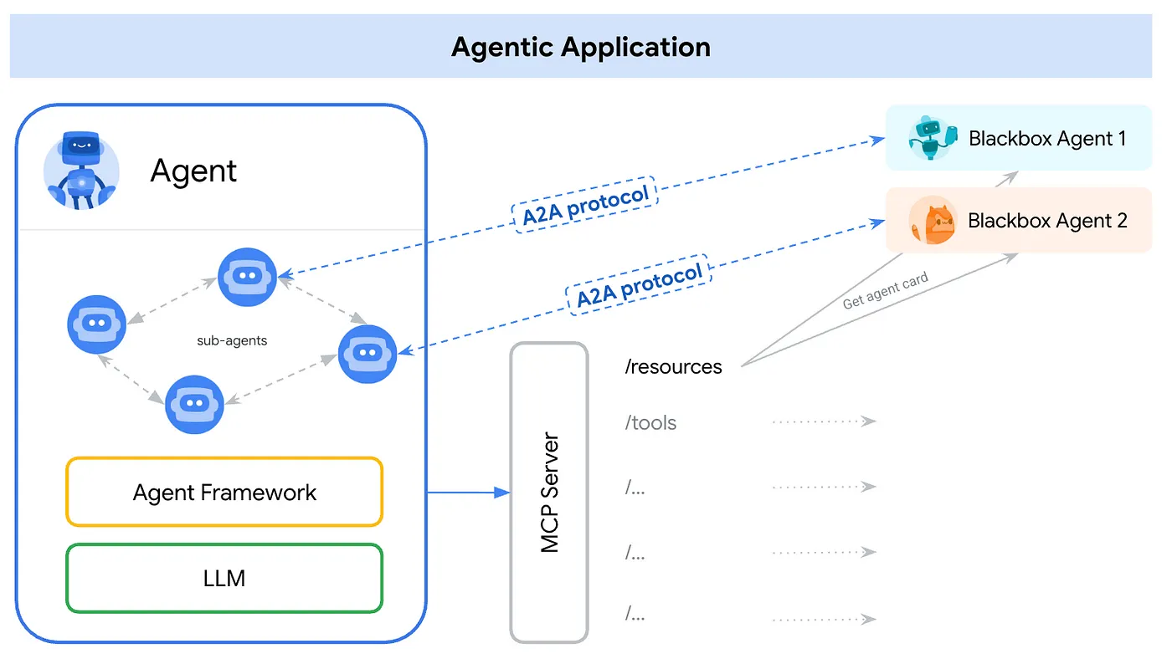

Slide 12
The Critical Challenge
How do we design AI Agents that can handle 10 million concurrent users without failing?
The challenge is intensified as we must guide our students to solve this issue with minimal financial resources available during training.
The Solution: DACA Design Pattern

Slide 13
DACA: Dapr Agentic Cloud Ascent
Overview: A design pattern for scalable, resilient agentic AI systems.
Core Tenets:
AI-First: Agents drive logic via OpenAI SDK, A2A, MCP.
Cloud-First: Scales via Docker/Rancher, Lens, Dapr, Kubernetes.
Components:
OpenAI Agents SDK (agent logic).
MCP (tool calling).
A2A Protocol (agent communication).
Dapr (distributed capabilities).
Vision: Enables Agentia World’s intelligent ecosystem.
Notes:
https://github.com/panaversity/learn-agentic-ai/blob/main/comprehensive_guide_daca.md

Slide 14
The Core Idea of DACA: Develop Anywhere
Use containers (Docker/OCI) as the standard for development environments for Agentic AI.
Ensure consistency across developer machines (macOS, Windows, Linux) and minimize "it works on my machine" issues.
Use open-source programming languages like Python, libraries such as Dapr, orchestration platforms like Kubernetes, applications like Rancher Desktop, databases like Postgres, and protocols like MCP and A2A.
Leverage tools like VS Code Dev Containers for reproducible, isolated development environments inside containers.
The goal is OS-agnostic, location-agnostic, consistent Agentic AI development.

Slide 15
The Core Idea of DACA: Cloud Anywhere
Use Kubernetes as the standard orchestration layer for AI Agent deployment. This allows agentic applications packaged as containers to run consistently across different cloud providers (AWS, GCP, Azure) or on-premises clusters.
Use Dapr to simplify building distributed, scalable, and resilient AI Agents and workflows.
Leverage tools like Helm for packaging and GitOps tools (Argo CD) for deployment automation.
The goal is deployment portability and avoiding cloud vendor lock-in.

Slide 16
AI-First Development in DACA
Definition: Prioritizes AI as the core of system logic from the start.
Key Features:
Autonomous agents powered by OpenAI Agents SDK.
Intelligent communication via A2A Protocol.
Tool integration with MCP for dynamic capabilities.
Why It Matters:
Enables adaptive, reasoning-driven systems.
Aligns with Agentia World’s vision of intelligent networks.
AI-first ensures agents drive innovation and autonomy.

Slide 17
Cloud-First Development in DACA
Definition: Builds systems for cloud-native scalability from day one.
Key Features:
Containerized agents (Docker/Rancher) for portability.
Serverless platforms (Azure Container Apps) for efficiency.
Kubernetes for planetary-scale orchestration.
Why It Matters:
Scales AI agents seamlessly from 10 to millions of users.
Leverages free-tier services to minimize costs.
Cloud-first powers DACA’s global reach.

Slide 18
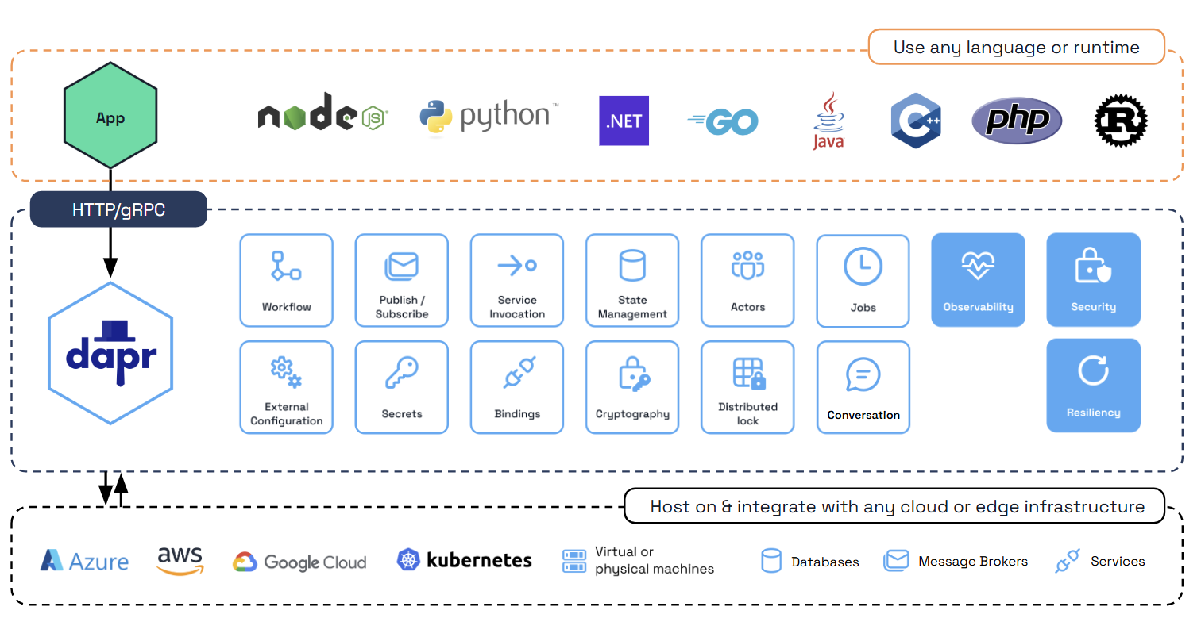

Slide 19
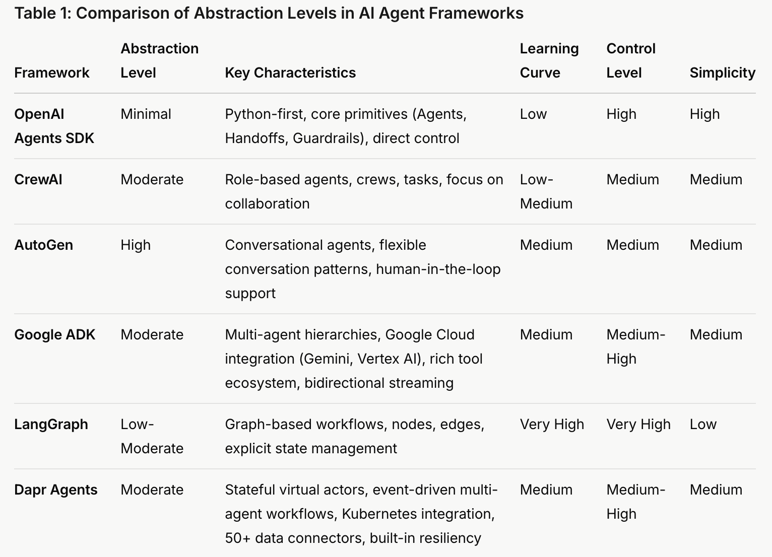
Why OpenAI Agents SDK should be the Main Framework for Agentic Development for Most Use Cases?
Notes:
https://github.com/panaversity/learn-agentic-ai/blob/main/-01_lets_get_started/01_which_agentic_framework/readme.md

Slide 20
DACA Main Components
01 Python
02 AI Agents
Modern Python Programming
Type Hints, Asyncio, Data Classes, Generics, etc.
OpenAI Responses API
OpenAI Agents SDK
03 FastAPI & MCP
04 DAPR & A2A
Containerized FastAPI for Building APIs with Asynchronous capabilities
Containerized MCP for Standardize AI Model Integrations and Tool Calling
Build Resilient, Stateless, and Stateful applications that run on the cloud with Dapr
Agent-to-Agent Communication with A2A protocol
05 Deploy & Scale
06 Monitor & Evals
Docker to Build Containers
Serverless Container Platforms for Enterprise Deployments
Kubernetes for Planet Scale
Use testing & monitoring tools for you Distributed AI Agents
Notes:
https://github.com/panaversity/learn-agentic-ai/blob/main/comprehensive_guide_daca.md

Slide 21
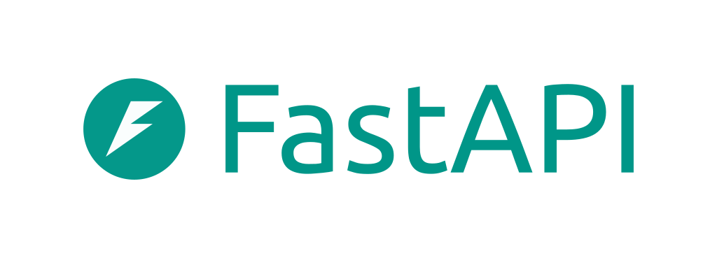
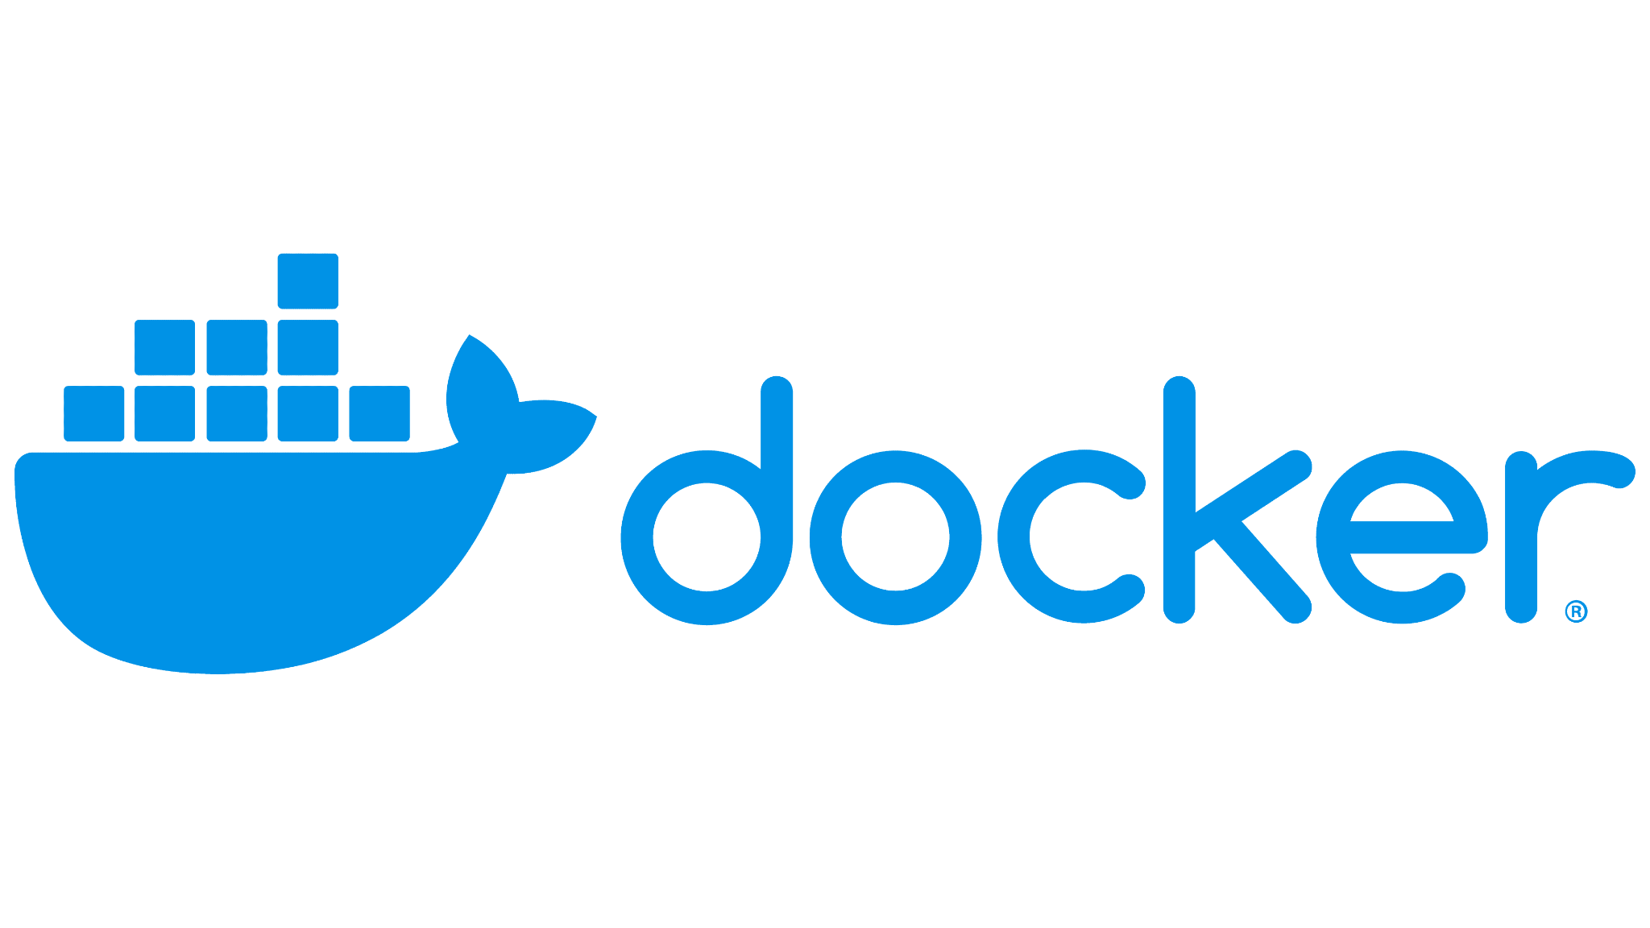
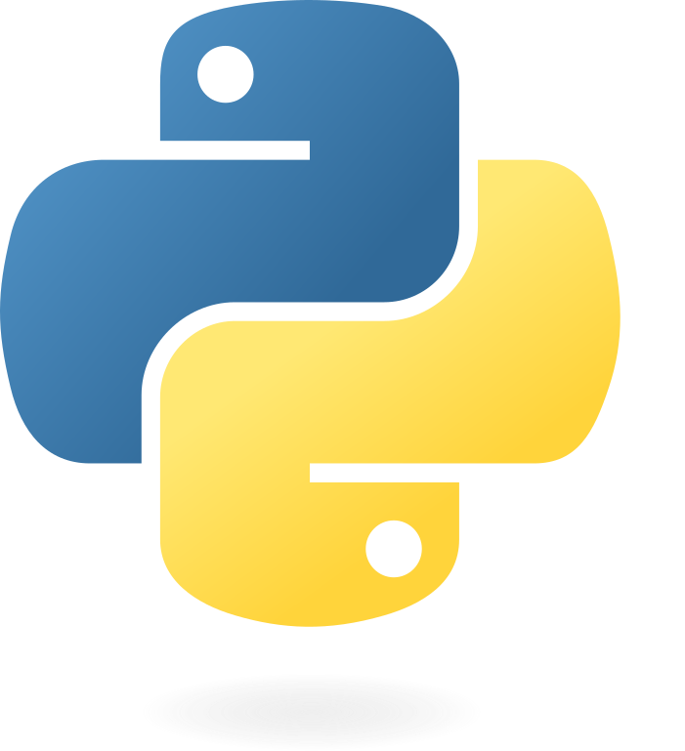



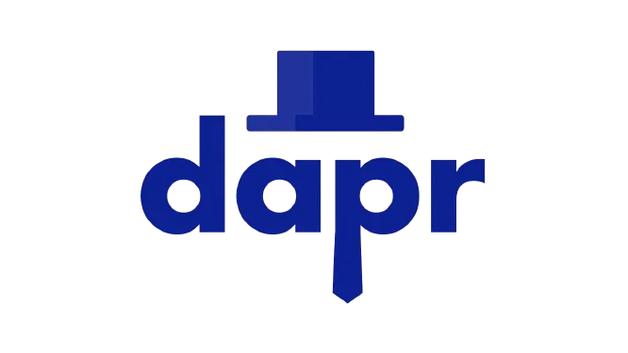

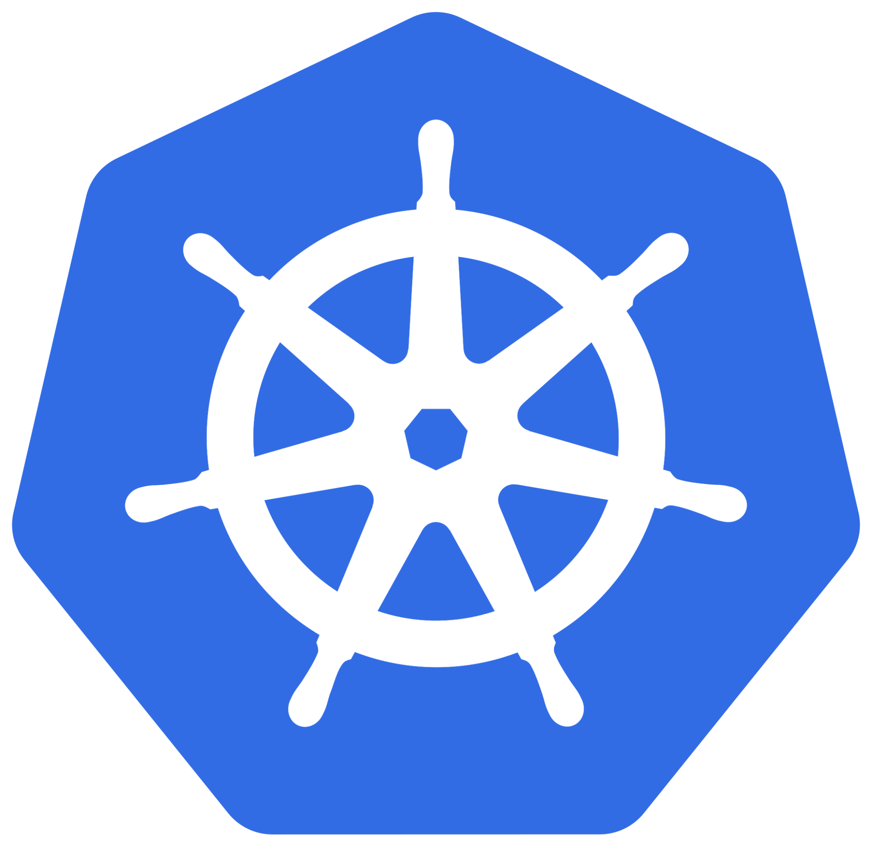

Presentation Layer (Next.js/Streamlit/Chainlit)
Containerized AI Agent
Responses API Agents SDK
Business Logic & AgenticI Workflows Layer
Sidecar Container
Dapr Agentic Cloud Ascent (DACA) Architecture
A2A Protocol Server
MCP Server
Kubernetes
Azure Container Apps (ACA)
Topic
Postgres
Pinecone
Neo4j
Data Layer
Messages
publish/subscribe
(Kafka, RabbitMQ, Redis)
Relational DB
Vector DB
Graph DB
Notes:
https://github.com/panaversity/learn-agentic-ai/blob/main/comprehensive_guide_daca.md

Slide 22
Paid
Planet-Scale Deployment (Millions of Users)
Free Forever Training Cluster
Kubernetes, Self-hosted LLMs (Meta's Llama, Google’s Gemma, DeepSeek), Kafka on Kubernetes, Postgres on Kubernetes, Dapr Agents
Pay As You Go
Enterprise-Scale Deployment (Thousands of Users)
Free Tier
Azure Container Apps (ACA) or any other Kubernetes Powered Serverless Platform, Azure Container Jobs, CockroachDB for distributed storage, Confluent Kafka
The DACA Multi-Agent Ascent
Prototyping Environment (10 -100 Users)
Free
Hugging Face Spaces, CronJob.org, Upstash Redis, CockroachDB, CloudAMQP (RabbitMQ)
Local Development Stage (1-10 Test Users)
Open Source
Rancher Desktop, Docker, Lens, DevContainer, FastAPI, Dapr, Dapr Workflows, OpenAI Agents SDK, MCP, A2A, Local Redis & RabbitMQ, Human-in-the-loop (HITL)

Slide 23
The Global AI Race: A New Frontier in Power
Investing in AI is now essential for global relevance.
AI is more than technology—it’s a pathway to economic power and geopolitical influence.
It also impacts the future of humanity.
The US and China are leading the AI charge.
Countries like the UK, Israel, and India are rapidly advancing.
AI is projected to add $15.7 trillion to global GDP by 2030 (source: Gartner).
Nations are investing heavily to capture these economic benefits.
Saudi Arabia Plans $100 Billion AI Project to Rival UAE.
Notes:
https://alltechmagazine.com/the-global-ai-race/

Slide 24
Market Demand for AI Jobs
High Demand for AI Talent: Fields like agentic AI, humanoid robotics, and physical AI are seeing rapid growth.
Top industries hiring for AI roles: tech, finance, healthcare, and manufacturing .
Lucrative Salaries: AI professionals can expect salaries ranging from $150,000 to over $200,000, with opportunities only expanding.

Slide 25
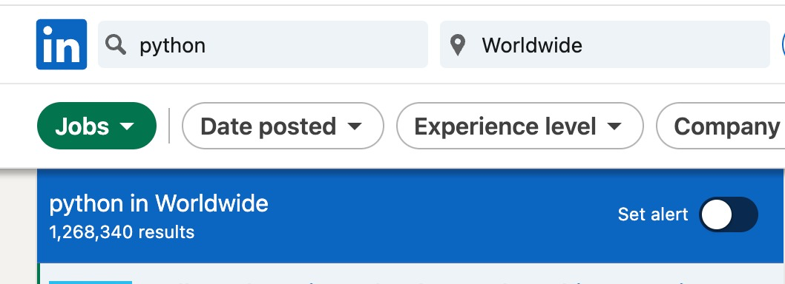
There are 1.2 million Python job openings listed on LinkedIn

Slide 26
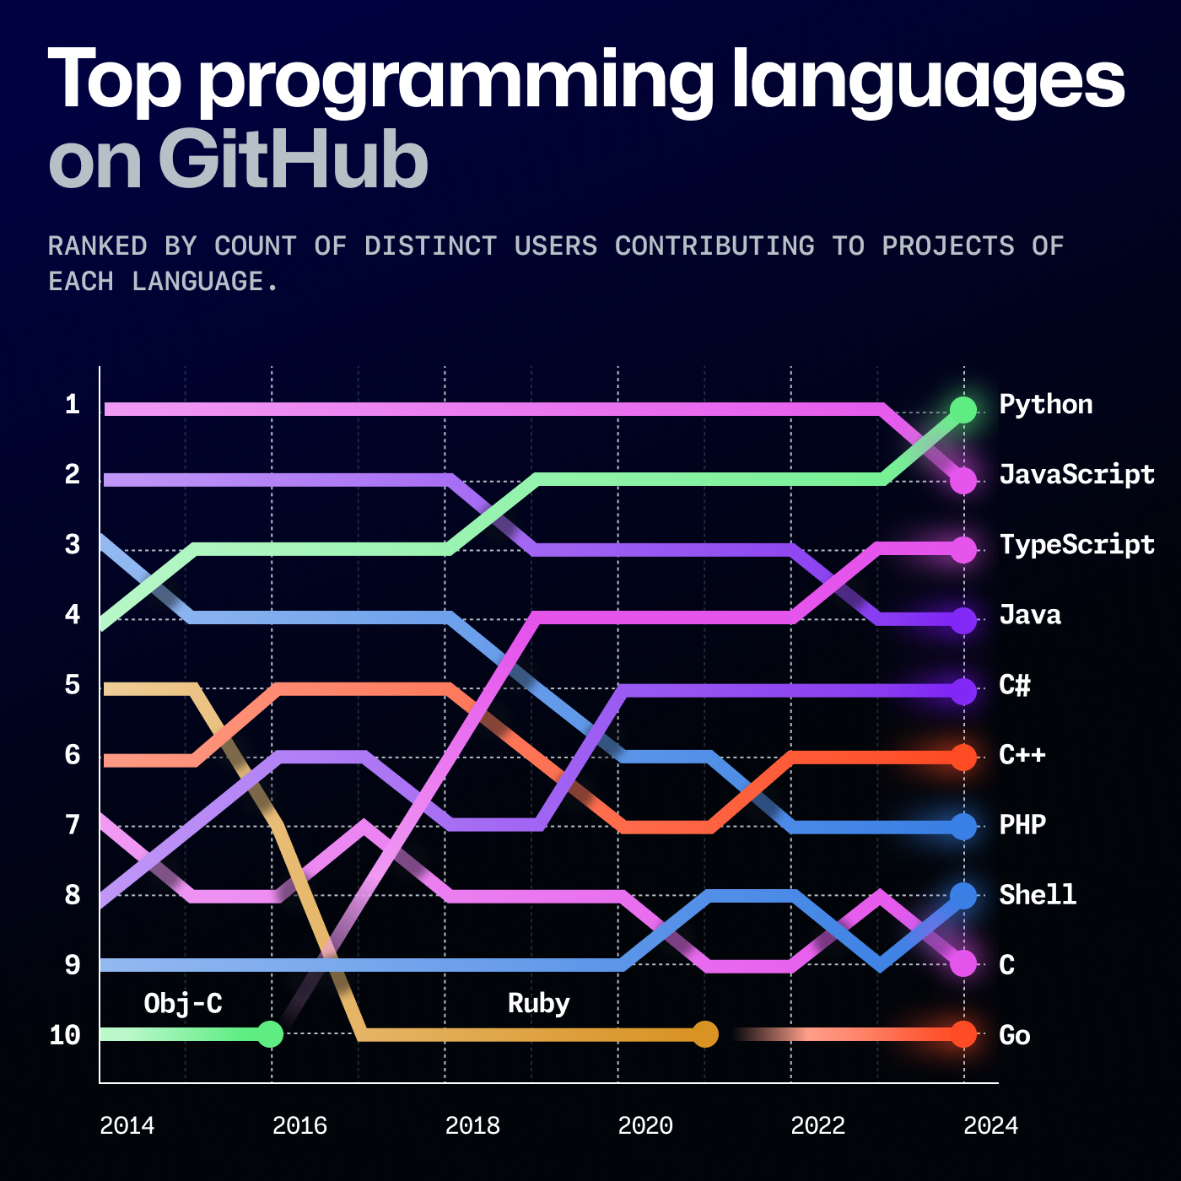
Notes:
https://github.blog/news-insights/octoverse/octoverse-2024/
https://www.youtube.com/watch?v=b5Ho2_Si6hY

Slide 27
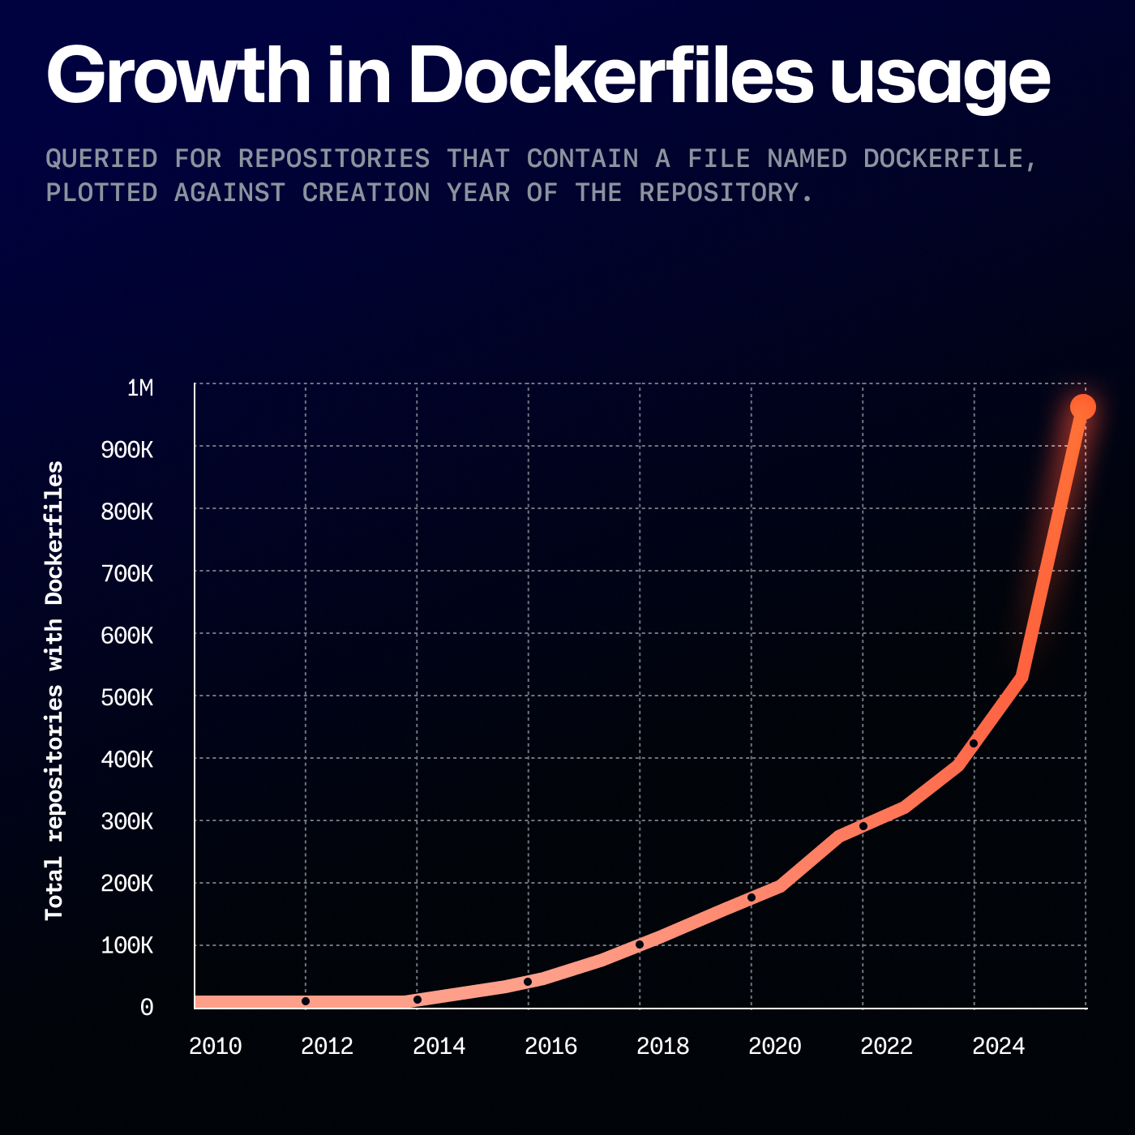
Cloud Native AI
Notes:
Cloud Native also rising with AI, it means developers are using AI based docker workloads
https://github.blog/news-insights/octoverse/octoverse-2024/

Slide 28

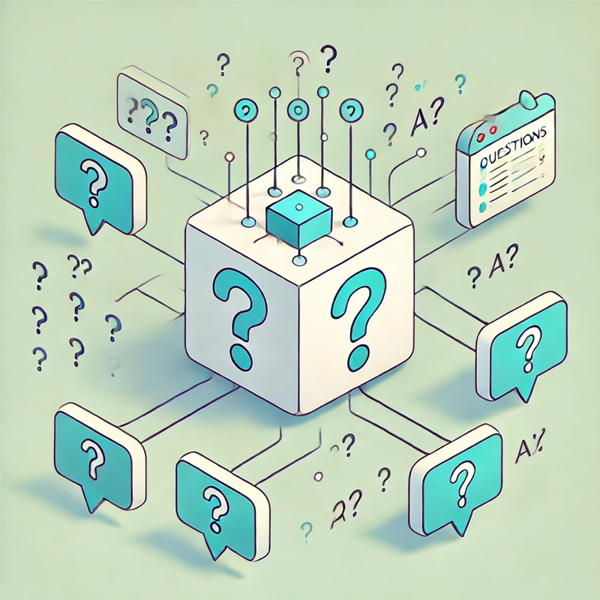
Two-Step Lifecycle and AI Model Pipeline
Training
Inference
Teaching AI to Understand Language
Using AI to Generate Responses

Slide 29
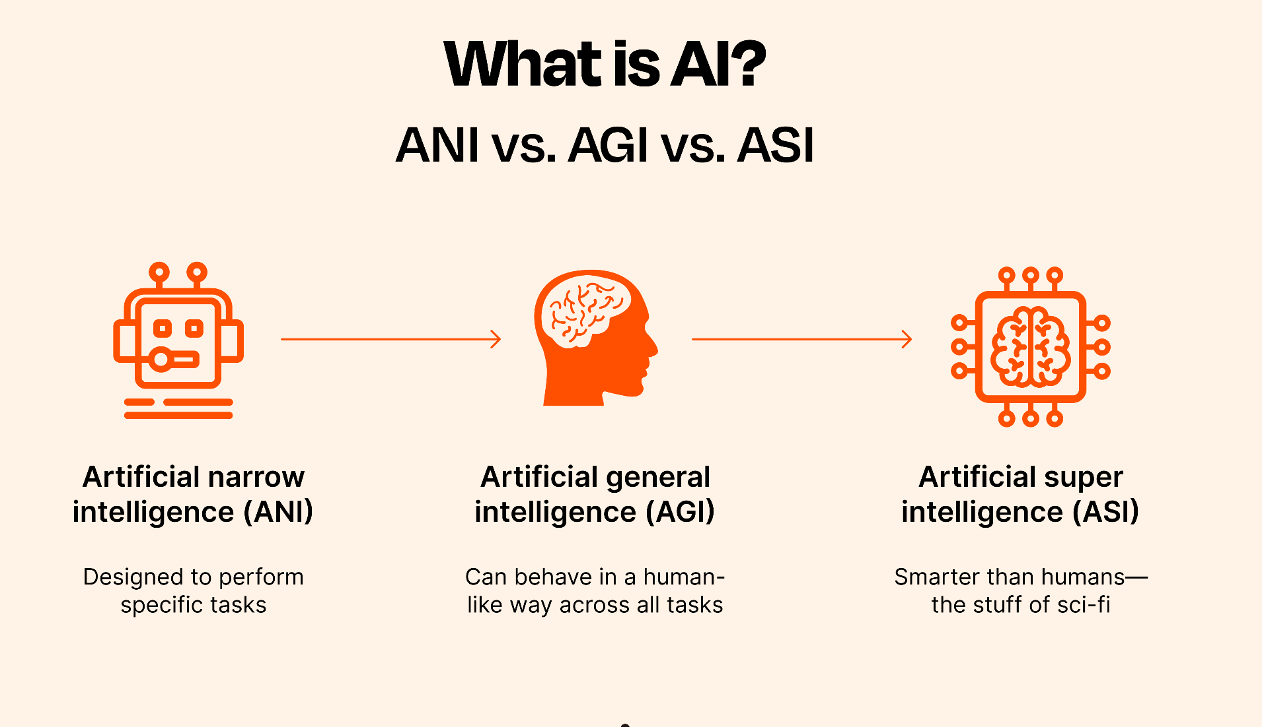

Slide 30
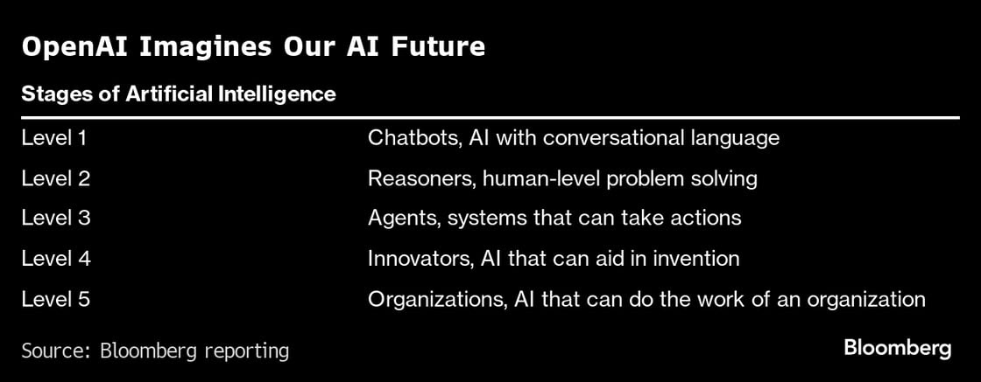
Road To AGI

Slide 31
Now we have Two Fundamental Scaling Laws
Training
Inference
Improvements in performance in LLMs been due to increases in model scale.
Size (number of parameters), training data volume, and computational resources.
Intelligence Requires Thinking.
The more you Compute the Higher Quality Answers You Provide.
This shift will move us from a world of massive pre-training clusters toward inference clouds, which are distributed, cloud-based servers for inference,
Notes:
https://www.facebook.com/share/r/1FHnoCVuq3/
https://www.facebook.com/reel/1245315079948292
https://www.reuters.com/technology/artificial-intelligence/openai-rivals-seek-new-path-smarter-ai-current-methods-hit-limitations-2024-11-11/

Slide 32
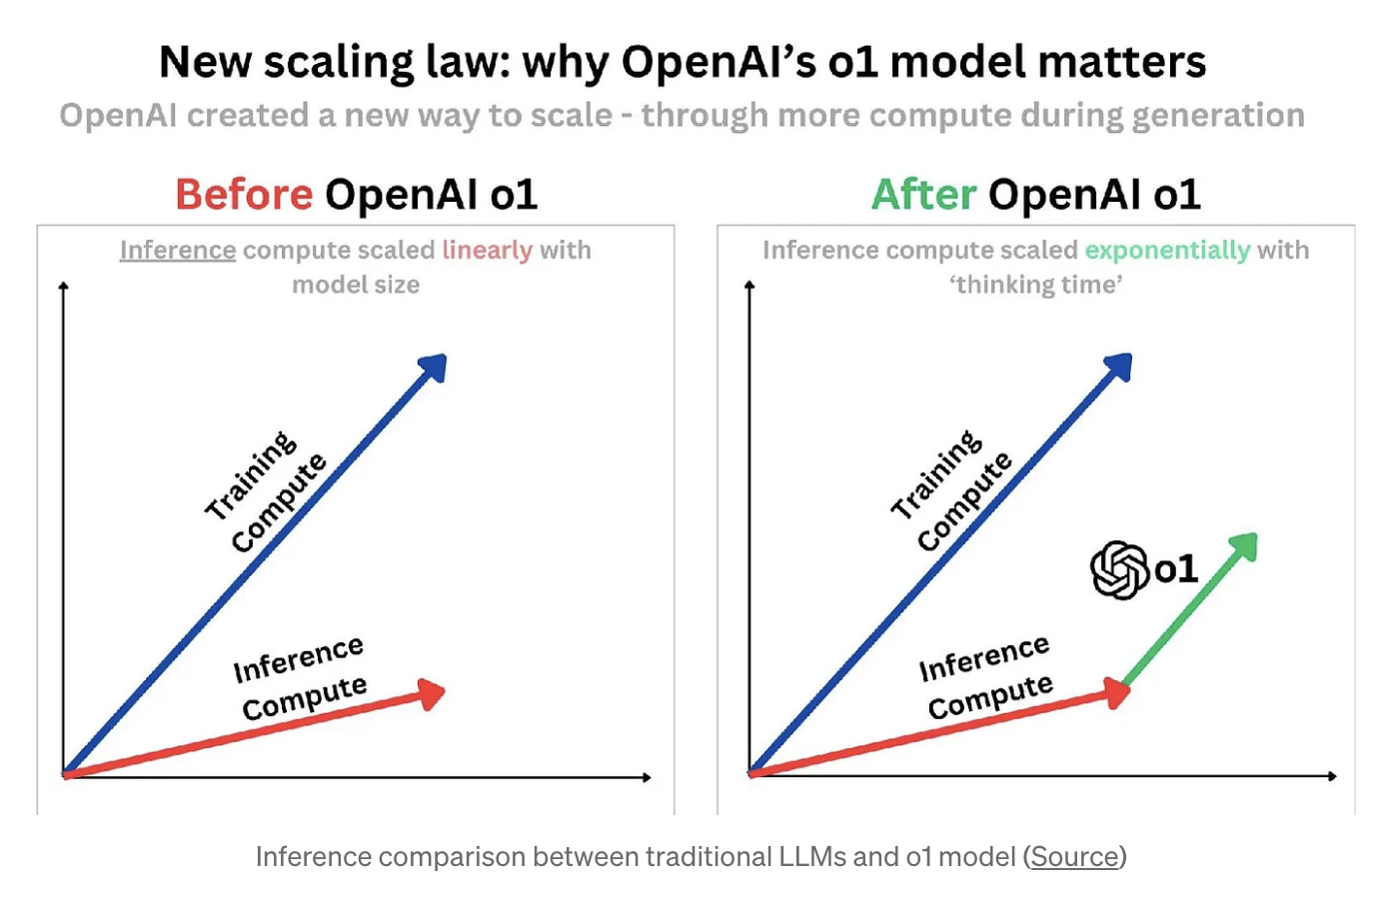
Notes:
https://medium.com/@aiml_58187/beyond-bigger-models-the-evolution-of-language-model-scaling-laws-d4bc974d3876

Slide 33
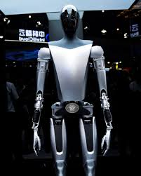
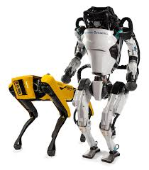
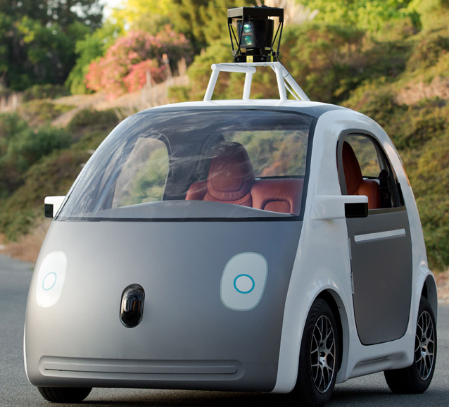
Level 3: Agentic AI
Agentic AI is like having a smart robot friend who can think and make decisions and take actions by itself, just like a real person.
Software Agents
Agentic AI
Physical Agents
Software agents are virtual entities that operate in digital environments. They perform tasks autonomously by interacting with software, data, and digital services.
Physical agents, also known as embodied agents, are AI entities that interact with the physical world. These agents often include humanoids, autonomous vehicles, and autonomous systems.

Slide 34
The Journey of Agentic AI
Neural Networks gave AI a brain to think.
GPUs helped AI learn fast by working on many things at the same time.
Transformers gave AI the ability to understand and communicate.
Tool Calling gave AI the ability to take
Action and connect to the world.

Slide 35
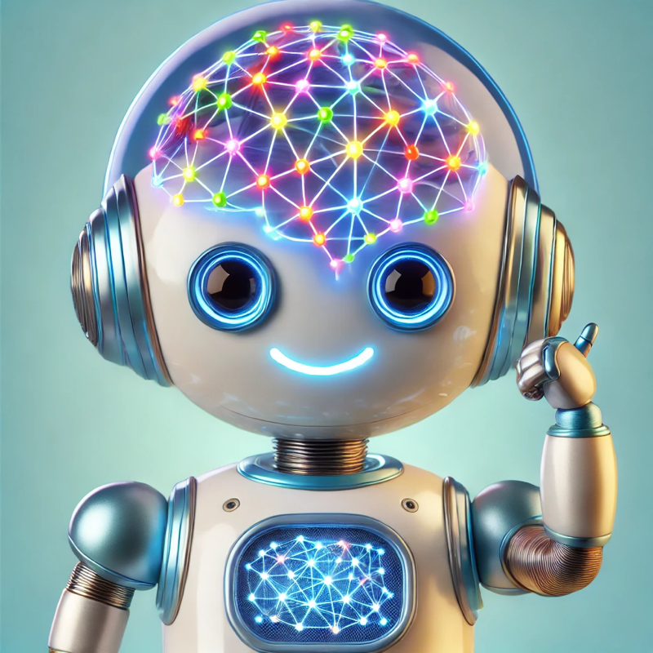
Neural Networks – The Brain of AI
AI Thinks Like Our Brains!
AI uses Neural Networks to think.
Just like our brains have lots of tiny cells talking to each other, neural networks are like tiny computer helpers working together.
These helpers teach AI to recognize pictures, understand words, and learn new things!

Slide 36
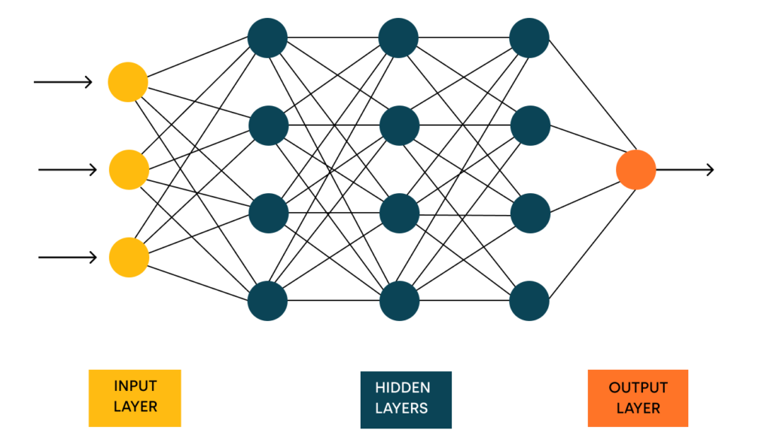
AI is Smart Because of Neural Networks!

Slide 37
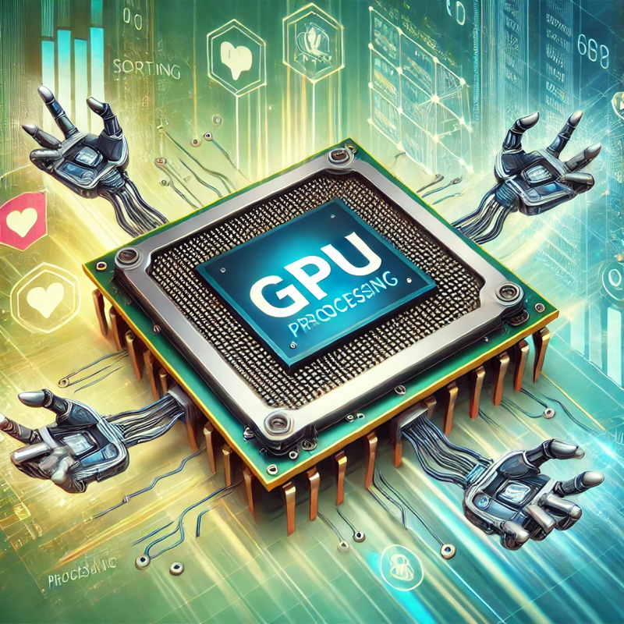
GPUs – The Muscles of AI
AI Needs Strong Muscles to Work Fast – That’s GPUs!
GPUs are special computer parts that work on many things all at once.
Imagine having lots of helpers doing small jobs together at the same time—that’s how GPUs work!
This is called working in parallel.
CPUs (normal computer brains) do one thing at a time, like a person building with one block at a time.
GPUs can handle many blocks at once, making things go much faster!
With GPUs, AI can learn from tons of information quickly, just like a team finishing a big puzzle faster than one person.

Slide 38
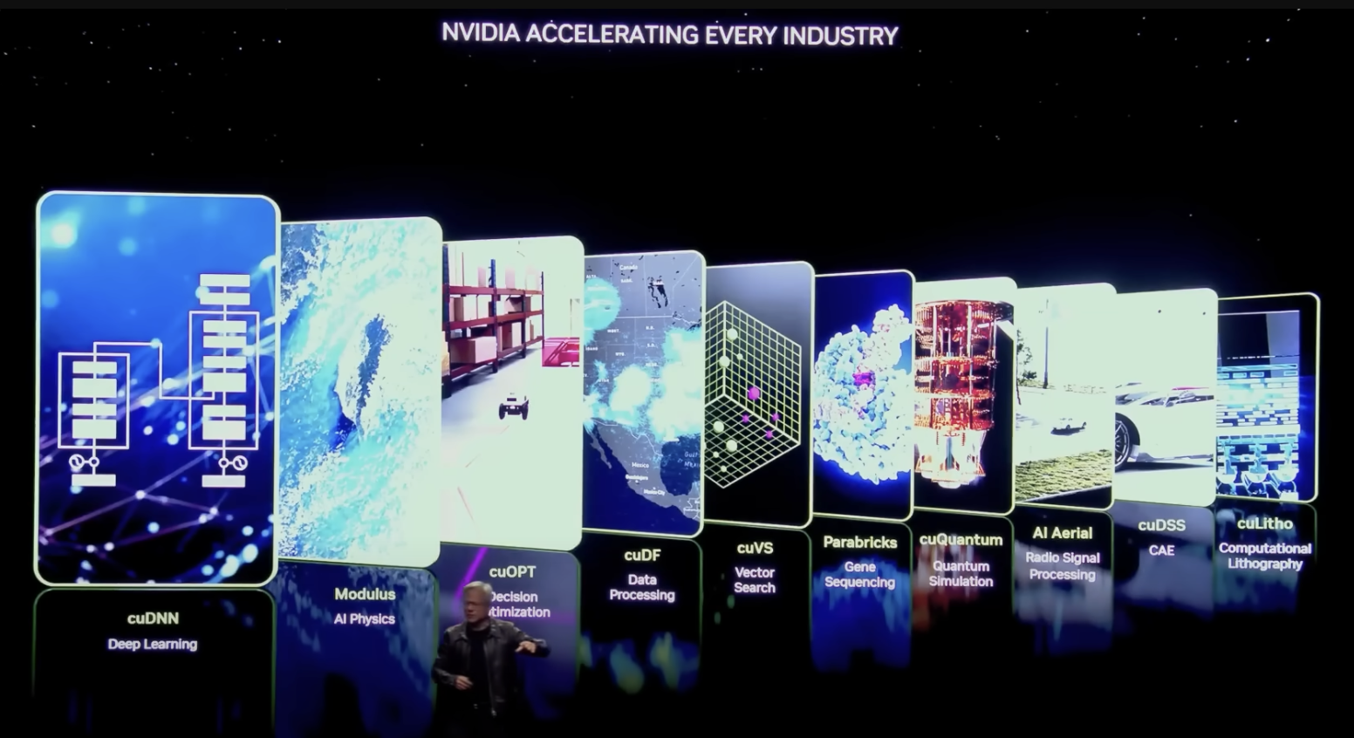
GPUs accelerate processes up to 100 times faster
Notes:
https://www.youtube.com/watch?v=JmpBqphgNhc

Slide 39
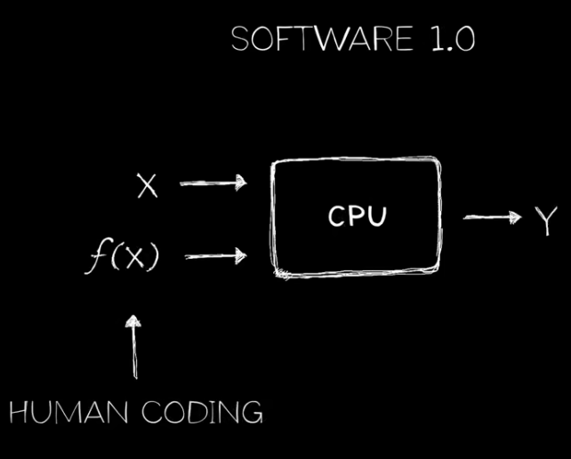
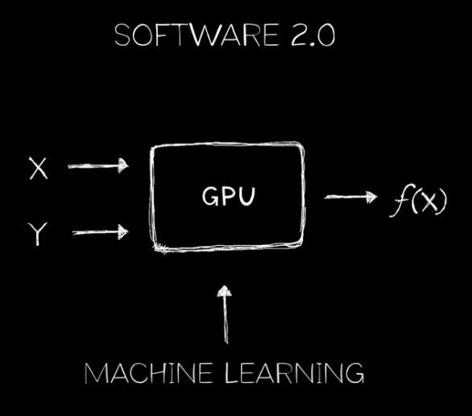
GPUs accelerate processes up to 100 times faster
Trained Model

Slide 40
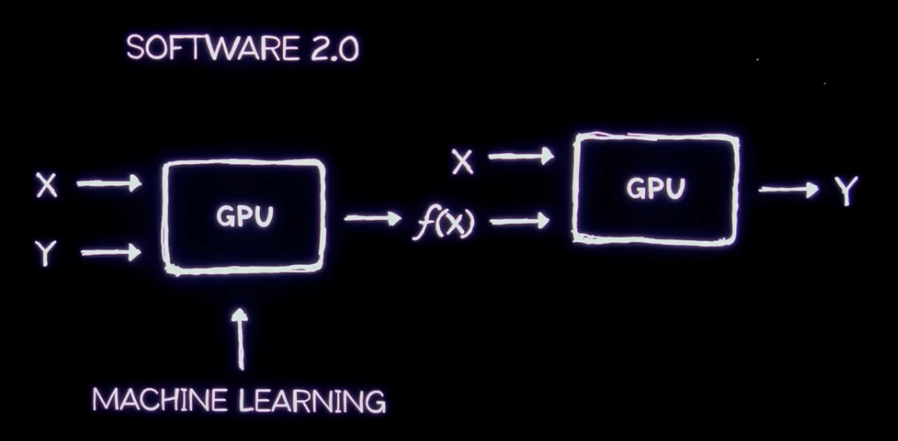
GPUs accelerate processes up to 100 times faster
Inference
Training
Trained Model

Slide 41
Tool Calling: A Core Feature of Agentic AI
Tool calling enables AI agents to autonomously select and utilize external tools or APIs to accomplish tasks beyond their inherent capabilities.
Significance in Agentic AI:
Enhances problem-solving by allowing AI to access specialized resources.
Facilitates dynamic decision-making through real-time data retrieval and processing.
Expands the functional scope of AI agents, enabling them to perform complex, multi-step operations.
Example:
An AI agent tasked with planning a trip can autonomously access flight booking APIs, hotel reservation systems, and local event databases to create a comprehensive itinerary.
Notes:
https://platform.openai.com/docs/guides/function-calling

Slide 42
Join the Fourth Industrial Revolution
You should be prepared not only for high-value job roles but also for leadership in AI’s next evolution, essential to the future economy

Slide 43
Let’s Build DACA
Vertical AI Solutions
Design & Build Intelligent Planet Scale
Vertical LLM Agents and bring
Agentia World to Life
Notes:
https://github.com/panaversity/learn-agentic-ai/blob/main/comprehensive_guide_daca.md

Slide 44
Vertical vs. Horizontal AI Solutions
Horizontal Solutions:
General-purpose AI for broad use cases (e.g., chatbots, LLMs).
Pros: Wide applicability, rapid deployment.
Cons: Lack depth, generic outputs.
Vertical Solutions:
Specialized AI for industry-specific tasks (e.g., logistics, healthcare, education).
Pros: Tailored, high-impact, domain expertise.
Cons: Narrower scope, higher customization.
Vertical solutions target specific industries (e.g., logistics, healthcare), while horizontal solutions are broad (e.g., general chatbots).

Slide 45
Our Focus: Vertical Agents
AI-first: Deep domain logic via OpenAI SDK, MCP, A2A.
Cloud-first: Scalable, industry-tuned deployments.
Example: Logistics agent optimizing supply chains with A2A.
Vertical agents drive precision in Agentia World.

Slide 46
Monetizing Vertical Agents
Why Vertical Agents Excel:
Targeted Value: Solve niche pain points (e.g., logistics, healthcare).
Premium Pricing: Expertise drives higher fees vs. horizontal agents.
Recurring Revenue: Subscriptions/usage fees ensure stability.
DACA’s Monetization Edge:
AI-First: OpenAI SDK, MCP tailor agents for industry ROI.
Cloud-First: Scalable delivery maximizes margins.
Industry Examples:
Logistics: $10K/month for route optimization (cf. Veeva’s healthcare SaaS).
Healthcare: $5/patient for triage automation (cf. ServiceTitan’s contractor fees).
Retail: $2K/month/store for inventory (cf. Toast’s restaurant subscriptions).
Construction: $15K/month/site for compliance (cf. Procore’s project management).
Vertical agents mirror vertical SaaS success in Agentia World.

Slide 47
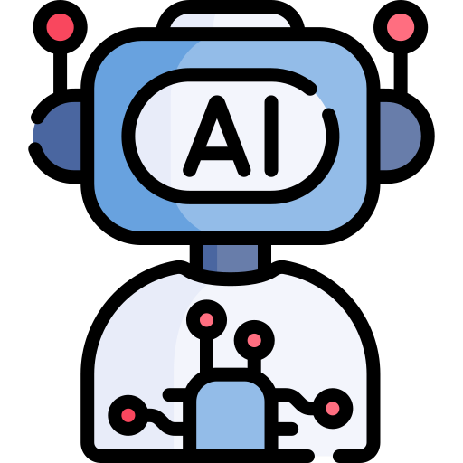
Think of agents as the new apps for an AI-powered world.
Every organization will have a constellation of agents. They will work on behalf of an individual, team or function to execute and orchestrate businesses process.

Slide 48
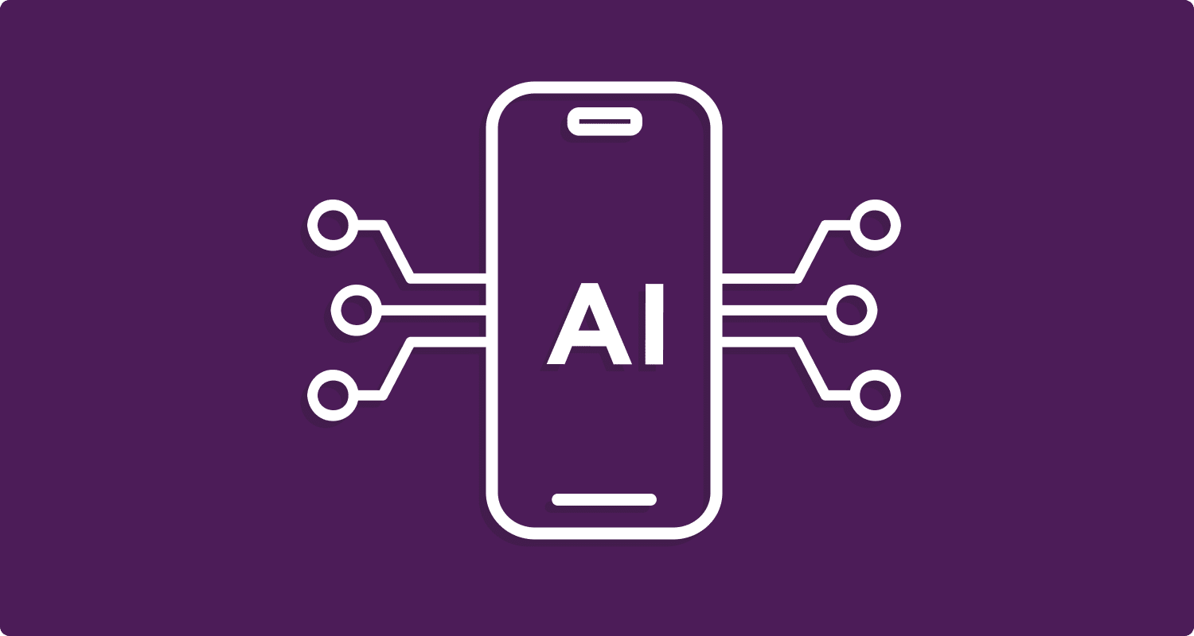
AI Agents will Replace SaaS and Apps
Your Apps Are on Borrowed Time.
AI Agents Are on the Way

Slide 49
Monetization Logic
Vertical agents’ specificity allows for higher customer retention (clients rely on tailored solutions).
Niche markets have less competition, enabling premium pricing.
Cloud scalability supports usage-based or subscription models, maximizing revenue per client.
Draws from industry trends where vertical SaaS outperforms horizontal platforms.

Slide 50
Vertical SaaS Outperforming Horizontal Platforms
Toast (Restaurants) is a vertical SaaS platform tailored for restaurants, offering point-of-sale (POS), payments, payroll, inventory management, and customer loyalty tools. Its industry-specific focus enables it to outperform horizontal POS platforms like Square and Clover, which target broad markets (e.g., retail, services, restaurants).
ServiceTitan (Home Services) is a vertical SaaS platform designed for home service businesses, offering tools for scheduling, dispatching, invoicing, marketing, and customer management, tailored to contractors like HVAC technicians, plumbers, and electricians. Its industry-specific focus enables it to outperform horizontal platforms like Salesforce and Zoho CRM, which serve broad industries (e.g., retail, tech, services).
Procore’s (Construction) $7B valuation (2024) reflects its dominance in construction, surpassing horizontal project management platforms like Trello ($10B acquisition but broader focus).
Mindbody Valued (Fitness & Wellness) at ~$2B (2024) outshines horizontal booking platforms like Calendly ($3B valuation but less specialized), as fitness businesses demand tailored tools.
Shopify’s (E-commerce, Semi-Vertical) $80B valuation (2024) reflects its e-commerce focus, outperforming fully horizontal platforms like Wix ($5B, broader scope), as retailers prioritize specialized commerce tools.

Slide 51
Why Vertical SaaS Outperforms Horizontal Platforms
Deep Industry Fit: Vertical solutions embed into specific workflows (e.g., Toast’s kitchen operations, Procore’s construction bids), creating indispensable tools. Horizontal platforms (e.g., Slack, Zoom) offer broad utility but lack depth, reducing pricing power.
Higher Margins: Specialized features justify premiums (e.g., ServiceTitan’s $10K/month vs. Salesforce’s $1K/month for generic CRM), as clients value ROI over cost. Vertical agents can charge $5K-$50K/month for high-impact automation (e.g., logistics cost savings).
Recurring Revenue: Integration into daily operations ensures subscriptions or usage-based fees (e.g., Mindbody’s 2-3% per booking). Agents can adopt similar models, charging per transaction (e.g., $1/order optimized).
Lower Churn: Vertical SaaS sees 85-95% retention due to switching costs (e.g., retraining staff on Procore). Vertical agents, embedded via A2A and MCP, create similar lock-in.
Valuation Premiums: Vertical SaaS commands 10-20x revenue multiples (e.g., Veeva at $20B with $2B ARR) vs. 5-10x for horizontal (e.g., HubSpot at $30B with $2B ARR), reflecting niche dominance. Agentic AI startups could follow suit.

Slide 52
Call to Action
Embrace the opportunities presented by Agentic AI and actively engage in its development and application.
Cultivate audacious leadership to navigate the transformative potential of AI effectively.
Foster collaboration and knowledge sharing within the Agentic AI community to accelerate progress and ensure responsible Agentic AI development.

Slide 53
Could Agentic AI Create a One-Person Unicorn?
Solopreneur
The AI revolution has already minted dozens of unicorns—startups valued at $1 billion before going public. Now it will create a whole new type of startup: The One-Person Unicorn
Notes:
https://fortune.com/2024/02/04/sam-altman-one-person-unicorn-silicon-valley-founder-myth/

Slide 54
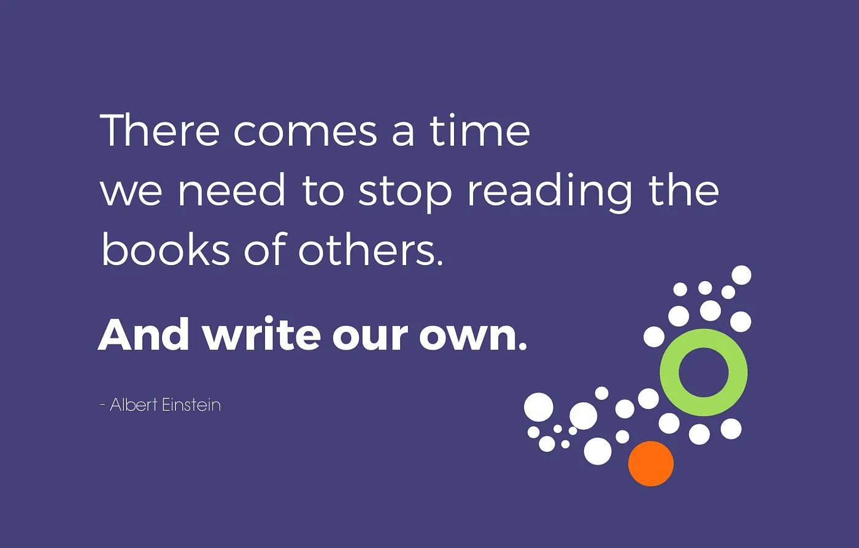

Slide 55
Audacious Leadership
Leading in a AI World

Slide 56
Audacious Leadership: Empowering You to Soar
Why Being Bold is Essential for Men and Women in Leadership Who want to Change Pakistan

Slide 57


Slide 58
Rethink Everything
‘We’re suddenly in a moment where it’s time to rethink everything’

Slide 59
Detailed Syllabus
http://bit.ly/3CpZtTY

Slide 60
Whatsapp Channel:
Latest News
https://bit.ly/49werTR

Slide 61
Thanks
https://www.linkedin.com/in/ziaukhan/
https://www.facebook.com/ziakhan/

